Slide 1

Welcome to the
First-Time Attendee Webinar
We will start at 2:35 PM ET.
While you wait, scan the QR code to explore the Early-Stage Investigator program and Career Development sessions.

Slide 2




Your Hosts
Emily Quarato, PhD
Post Doctoral Scholar
Washington University in St. Louis School of Medicine
Joseph Stains, PhD
Professor
University of Maryland School of Medicine
emilyq@wustl.edu
jstains@som.umaryland.edu
@emy9941
@Stains_Lab
@emy9941.bsky.social

Slide 3
Is this your first conference? First time at ASBMR?
First Scientific Conference
First ASBMR
Annual Meeting

Slide 4
ASBMR Annual Meeting
ASBMR has…
Plenary symposia and special sessions
Meeting Basic, Translational and Clinical highlights
ASBMR/ECTS clinical debate, symposia
Oral presentations
Poster sessions in the Discovery Hall
Meet the Professor, Symposia
Career Development Sessions
Networking breaks:
  Welcome reception
  ASBMR Social Event
Rapid Fire sessions
ASBMR News
Regional Meet-Ups
New this year:
  Bone 101: Fundamentals of Bone Biology
  Public Outreach Session
  Innovation Pitch Competition
  Highlights of the Year in Bone

Slide 5
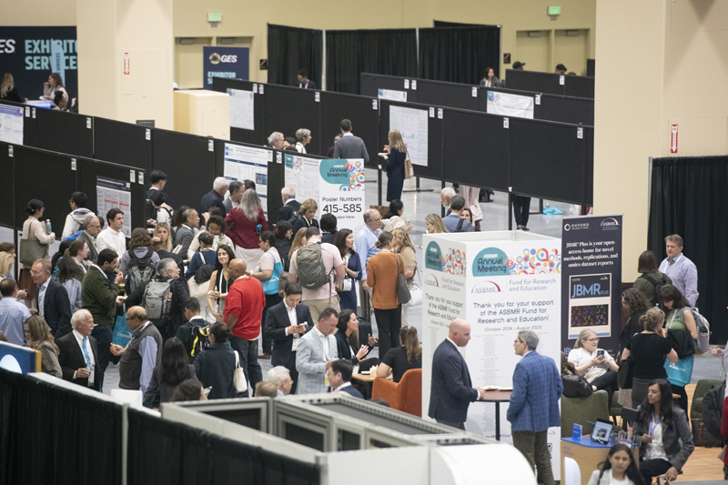
Some terminology you should know!
Acronyms
ASBMR: The American Society for Bone and Mineral Research
ESI: Early-Stage Investigator
NIH: National Institute of Health
Terminology
Plenary Poster Session: A special poster session featuring highly-scored abstracts. This session also includes a “happy hour” and social networking opportunity!
Meet the Professor Sessions: Discussion-based educational events led by experienced clinicians or senior scientists
Discovery Hall: Primary location for vendors, posters, informal networking spaces, and special events

Slide 6
“Bone 101: Fundamentals of Bone Biology”
Chairs: Elizabeth Zimmerman, PhD, and Lauren Surface, PhD
Friday, October 9
12:30-1:30 PM
Meeting Room 311 (John B. Hynes Veterans Memorial Convention Center)
Bone Cells and Signaling Pathways: Paola Divieti-Pajevic, MD, PhD; Translational Dental Medicine, Goldman School of Dental Medicine, Boston University, Boston, MA, USA
Hormonal Control of Skeletal Processes: Garyfallia (Fay) Papaioannou, MD, PhD; MGH, Brookline, MA, USA
Tools for Evaluating Bone Mass and Quality: Frank Ko, PhD; Rush University, Chicago, IL, USA
Key Mouse Models Used for Bone Research: Josephine T. Tauer, PhD; Department of Pediatrics and Adolescent Medicine, Johannes Kepler University Linz, Austria
Notes:
Career Development Session
https://asbmr.confex.com/asbmr/2026/meetingapp.cgi/Session/1518

Slide 7
“Multiverse of Science Careers: Pathways in Research, Medicine, Industry, and Advocacy”
Moderators: Lauren Surface, PhD and Rachel Elam, MD
Saturday, October 10, 2026
12:45-1:45 PM
Meeting Room 312 (John B. Hynes Veterans Memorial Convention Center)
Rare Disease Non-Profit Director: Tracy Hart, BS, OI Foundation
Medical Science Liaisons:
  Maria Barr, PharmD, Alexion
  Amel Dudakovic, PhD, Amgen
  Brian Sicari, PhD, Amgen
Pharma, Senior Scientist: Michael Friedman, PhD, Merck
Biotech: Yves Sabbagh, PhD, Stealth Mode Biotech
Education Research: John Drazan, PhD, Fairfield University
NIH Program Officer: Kristy Nicks, NIH PO
Clinician Scientist: Benjamin Levi, MD, UT Southwestern
Research Compliance: Curtis Van Slyck, MBA, Northeastern University
Journal Editor: Sejal Vyas, PhD, Cell Press
Consultant/Program Management: Kunle Demuren, PhD, Priovant Therapeutics
Patent Law (Lando & Anastasi):
  John Spangenberger, JD
  Amanda Caradona, JD
Small Pharma/Regulatory Affairs: Ricardo Dent, MD, Angitia
Science Policy: Jason Marvin, PhD, AIMBE
Round-tables with panelists (rotate every 15 minutes)

Slide 8
“Meet the NIH”
Saturday, October 10, 2026
5:00-6:00 PM
Meeting Room 310 (John B. Hynes Veterans Memorial Convention Center)
NIH Program Officers and Scientific Review Officers from relevant NIH institutes
Format is a brief overview by NIH officials followed by a Q&A session with attendees
Meant to give attendees an idea of how NIH and NIH grants work, which grants are appropriate for which career stage, etc.
A very interactive session, so bring your questions!

Slide 9
“International Meet-ups”
Saturday, October 10
5:00-6:00 PM
Meeting Rooms 309, 310, and 313 (John B. Hynes Veterans Memorial Convention Center)
These interactive sessions will bring together researchers and society leaders from across the region to celebrate scientific achievements, share regional updates, and strengthen professional networks. Attendees will gain an overview of abstracts presented by investigators from the region at the Annual Meeting, learn about recent progress, challenges, and opportunities across regional bone and mineral research communities, and hear examples of successful regional collaborations and standardization initiatives. The session will also highlight the importance of sustainable networking among basic, translational, and clinical researchers while fostering new connections to support future collaboration and scientific advancement.
(Room 309) Exploring Global Research in Bone Science - Fostering New Connections with the Central and South American Regions
(Room 310) Exploring Global Research in Bone Science - Fostering New Connections with the Africa, Middle East and India Regions
(Room 313) Exploring Global Research in Bone Science - Fostering New Connections with the Asian Pacific Regions
Notes:
Presenter: Emily
Asian Pacific: https://asbmr.confex.com/asbmr/2026/meetingapp.cgi/Session/1406
Africa, Middle East: https://asbmr.confex.com/asbmr/2026/meetingapp.cgi/Session/1405
South America: https://asbmr.confex.com/asbmr/2026/meetingapp.cgi/Session/1404

Slide 10
Prepare to Present

Slide 11
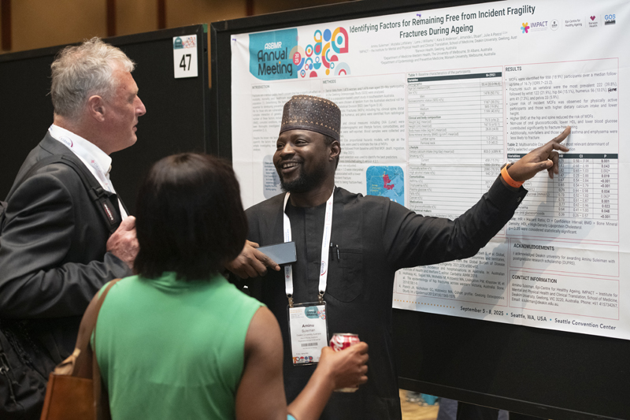
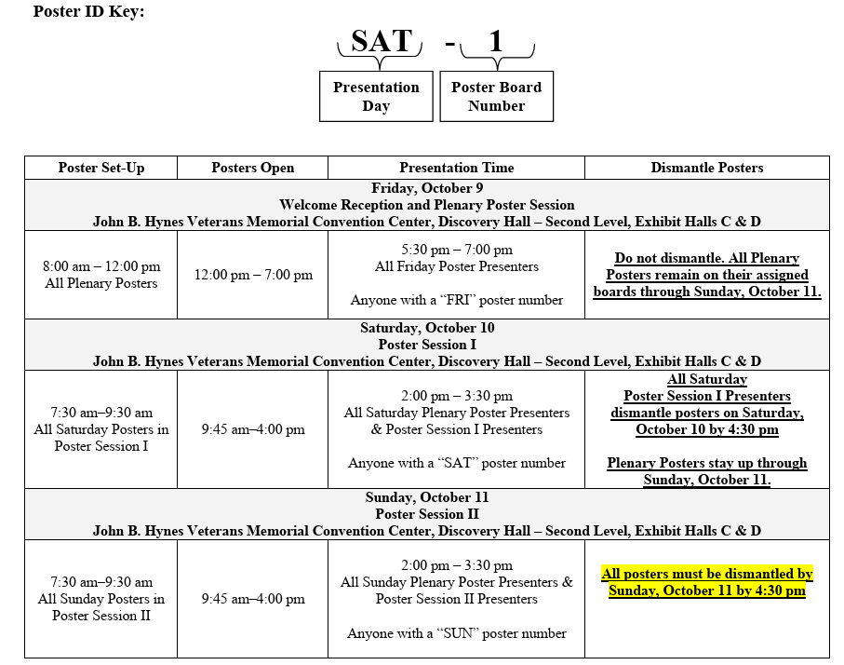
Posters
Average posters are 36 inches high and 48 inches wide.
Look up poster your number in advance and put up poster by 9am on day of presentation in the Discovery Hall.
Plenary posters remain up from Friday through Sunday. All other posters are put up and taken down on day of presentation

Slide 12
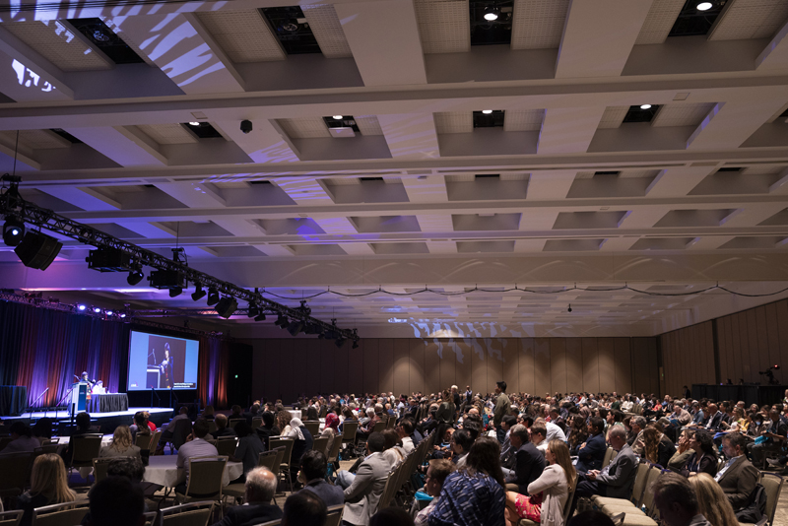
Rapid-Fire Presentations
Check into the Speaker Ready Room 24 hours in advance of your presentation.
The Early Career Spotlight Rapid Fire presentations are 5 minutes and up to 5 slides per presenter.
Announce your poster number at the end of your talk – this will allow attendees to visit your poster for any follow up questions.
TIPS:
  Hit the Highlights! DO NOT try to put all your data into this 5-minute presentation!
  Leave the audience wanting more so they come to your poster and talk to you!

Slide 13
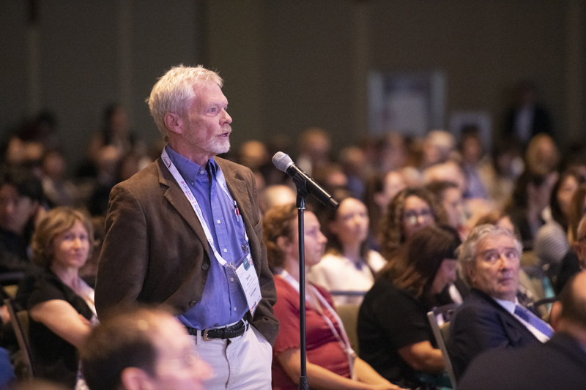
Oral Presentations
Speakers must check into the Speaker Ready Room 24 hours in advance of their presentation.
Your presentation is scheduled for 12 minutes.
  8-minute presentation
  4-minute Q&A
Arrive at 15 minutes before the start of the session and check in with the moderators of the session so they can verify your participation.
TIPS:
  Aim for 1 minute per slide
  Speak slowly and clearly, sometimes less is more!
  For the Q&A session, repeat the question to ensure you understood!

Slide 14
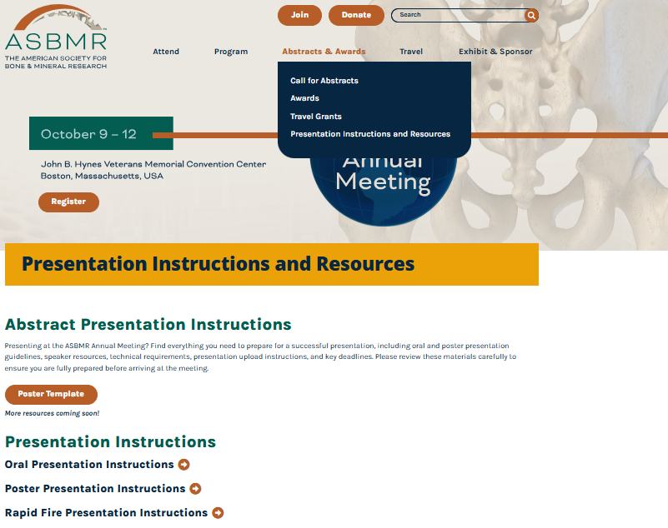

Presentation Resources
https://meeting.asbmr.org/Abstracts-Awards/Presentation-Instructions-and-Resources

Slide 15
Getting Ready for ASBMR

Slide 16
Read Abstracts
Research the program
  Familiarize yourself with the meeting program
  Highlight sessions, panels, or keynotes that you want to attend
Deepen your knowledge and explore new topics
  Attend sessions and visit posters that align with your research and interests
  Attend sessions on topics outside your area of expertise
    Meet the Professor (MTP sessions) are a great way to do this!
Connect with industry partners
  Introduce yourself throughout Discovery Hall

Slide 17


Itinerary Builder
Build your itinerary
  Search speaker names and keywords
  Add sessions, panels, keynotes, and posters you want to attend
  Connect with other attendees and colleagues
A great place to start
  Highlights of the Annual Meeting
  Plenary poster session
  Networking and social events
  Career Development sessions
Access the
Itinerary Builder
Notes:
FYI: Annual Meeting registrants will receive an email once the mobile app becomes available.

Slide 18

“Pre-Networking”: Social Media
Skip the business cards
  Are your ResearchGate and LinkedIn up to date?
  Be active on Twitter/X and BlueSky
    @ASBMR
    #ASBMR2026
Reach out now
  Email or DM PIs and peers you’d like to meet in Boston
    ASBMR’s The Exchange
    Mobile app DMs
  Suggest 5-minute meetings
    Discovery Hall
    Grab a coffee between sessions
  Subject lines: “Introduction and coffee at ASBMR?” or “5 minutes to meet at ASBMR?”
    Brief introduction
    What you’d like to discuss (hint: something about their abstract!)
Less is more
  Don’t overbook yourself! Be strategic with who you’d like to meet and about what

Slide 19
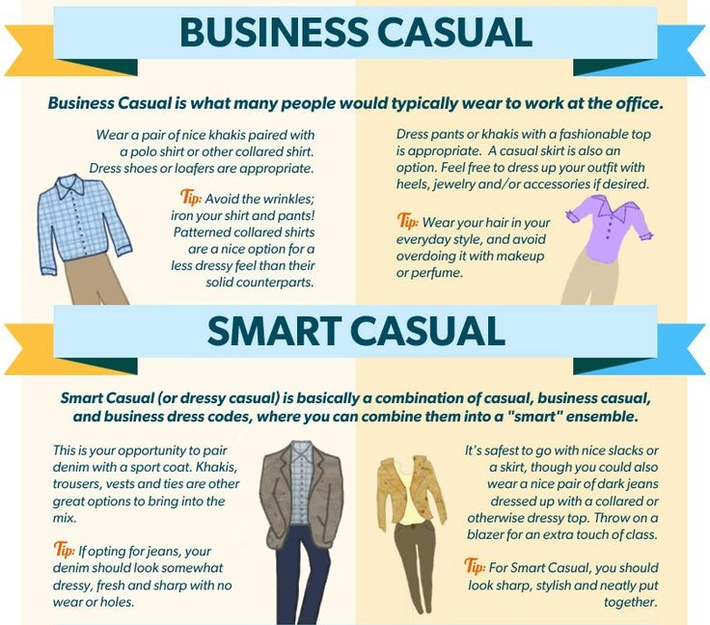
Pack Your Bags
Plan what to wear for each day of the conference
  Saves time in the morning
  Bring a jacket
  Don’t forget earbuds or headphones
  White Sneakers
Build your “conference kit”
  Band-Aids, ibuprofen, etc.
  Portable chargers
Backpack, briefcase, or tote bag
  Extra pens, notebook
  Water bottle and snacks
Downtime
  Exercise and casual clothing
  Book or e-reader, gaming device, tablet, etc.
Common Attire
  Business casual (day-to-day)
  Smart casual (presenting)

Slide 20
Know Your Location

Slide 21
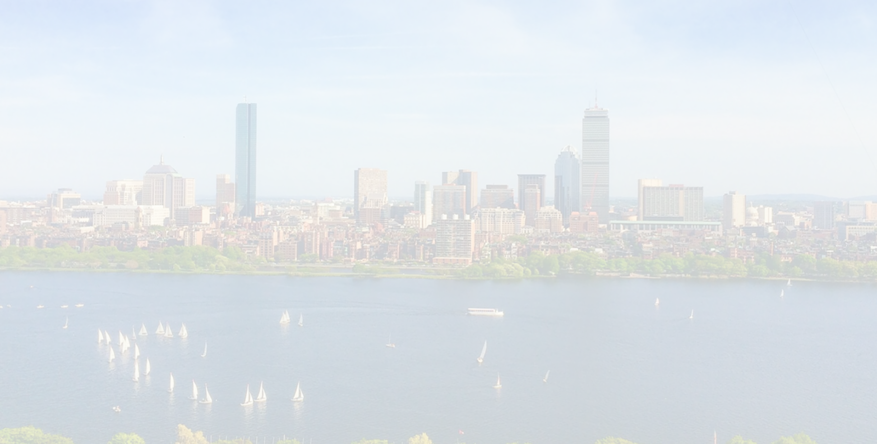


Know your Location
Fuel up
  Coffee
  Breakfast and late-night food
  Pick up some snacks
  Generate a list of places walking distance from the convention center
Be aware of your surroundings
  Weather forecast: low 80s F, partly cloudy
  Don’t wear your ASBMR badge outside of the convention center
  Walk or use the MBTA subway and bus systems
    Get a CharlieCard or use contactless payment (debit/credit card, phone, or watch with a mobile wallet) for public transportation
Explore and recharge
  Newbury Street (0.1 mi/0.16 km, 1-minute walk)
  Prudential Center (0.1 miles/0.16 km, 2-minute walk)
  Boston Public Garden (0.8 miles/1.3 km, 15-minute walk)
  Museum of Fine Arts (0.8 miles/1.3 km, 15-minute walk)
  Flight Club Boston (1 mile/1.6 km, 20-minute walk)

Slide 22
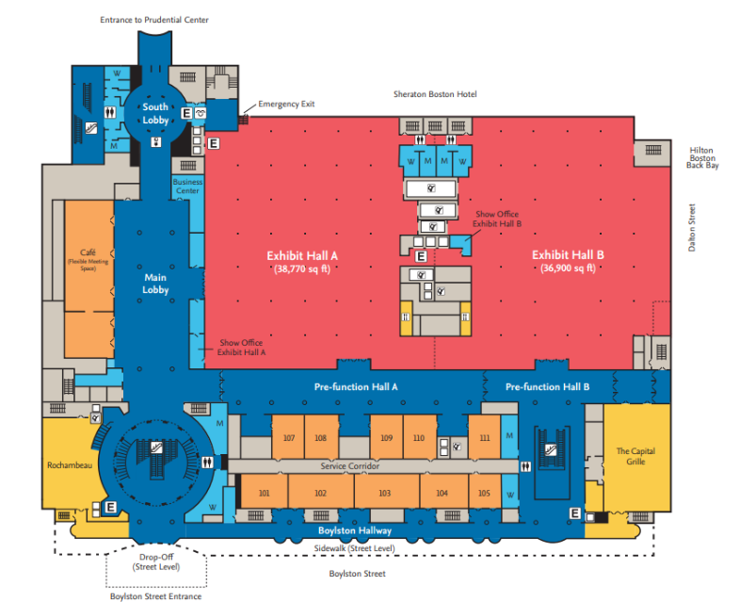
Venue Floor Plan - Hynes Center 1st Floor
Plenary Room
Tradeshow Floor: Exhibit Halls A&B
4 Concurrent Oral rooms
MTP sessions
Working Groups
Public Session
Reception Area
Speaker Ready Room
Ancillary/ICW

Slide 23
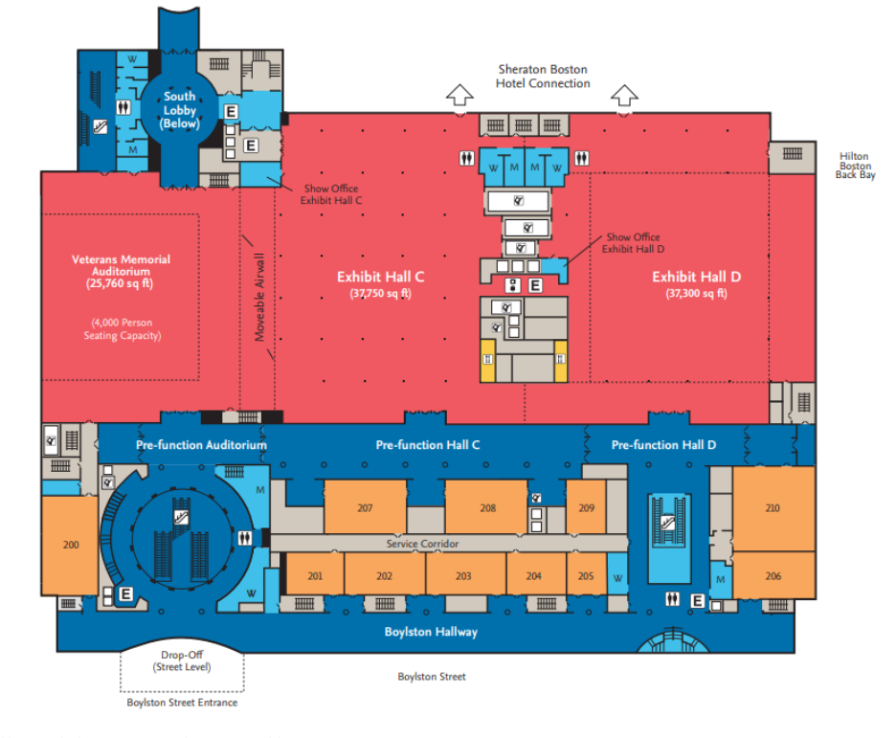
Venue Floor Plan - Hynes Center 2nd Floor
ISS / Working Groups
Reception Hall: Exhibit Hall C&D

Slide 24
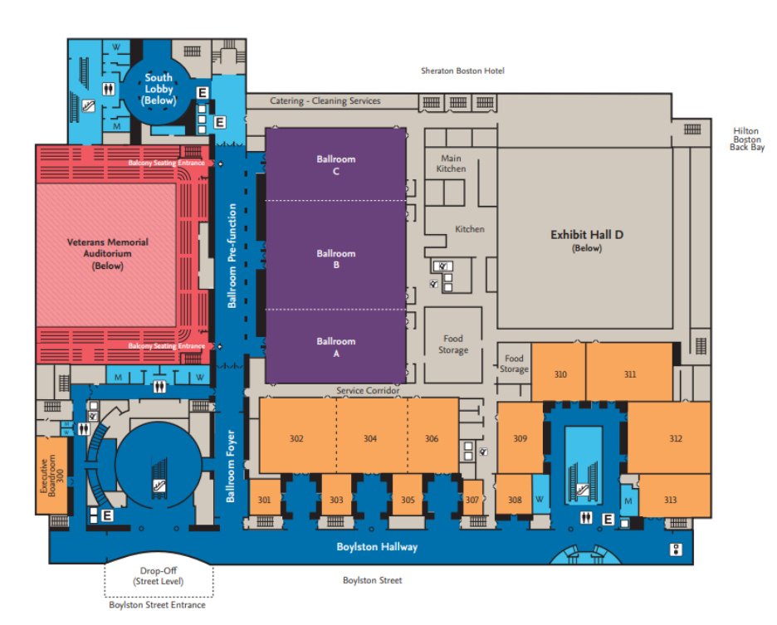
Venue Floor Plan - Hynes Center 3rd Floor
General Session: Ballroom A/B
Concurrent Session: Ballroom C, 302, 304, 306
Reception Hall: Exhibit Hall C&D
Town Hall: Sunday, 10/11, 6:15-7:15 PM, Room 306
Notes:
Town Hall: https://asbmr.confex.com/asbmr/2026/meetingapp.cgi/Session/1435

Slide 25
Networking

Slide 26
Networking - You’ve Already Done it!
Attended ASBMR First Time Attendees Seminar!
Prepared Micro- and mini-elevator pitches
Set up social media accounts and followed ASBMR
Email PIs/peers to meet at ASBMR and set up meetings
Discovered a place to grab a coffee or food with new friends
Chat with someone in the ESI Lounge about Career Development
Explored the city with new friends
Go to ASBMR networking events

Slide 27
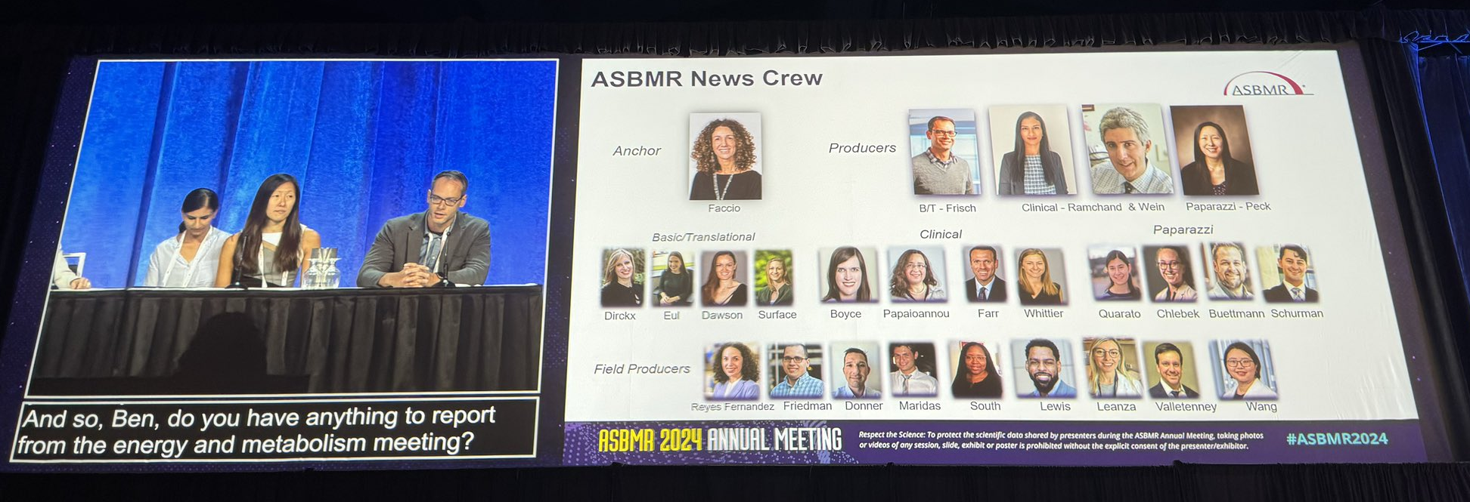
Where to Network
Formal Networking
Plenary Poster Session (Discovery Hall in Exhibit Hall C&D; Friday, 10/9, 5:30-7pm)
Main Poster Sessions (Discovery Hall in Exhibit Hall C&D; Saturday, 10/10-Sunday, 10/11, 2-3:30pm)
Immediately after an oral session (Lecture Halls/coffee breaks)
Career Development Sessions (Lecture Halls)
Meet the Professor Sessions (Lecture Halls)
International Meetup Sessions (Saturday, 10/10, 5-6pm)
Notes:
Discovery Hall Hours: https://meeting.asbmr.org/Exhibit-Sponsor/Exhibit
- Friday, October 9: 12:15 p.m. - 6:30 p.m.
- Saturday, October 10: 9:30 a.m. - 4:00 p.m.
- Sunday, October 11: 9:30 a.m. - 4:00 p.m.

Slide 28
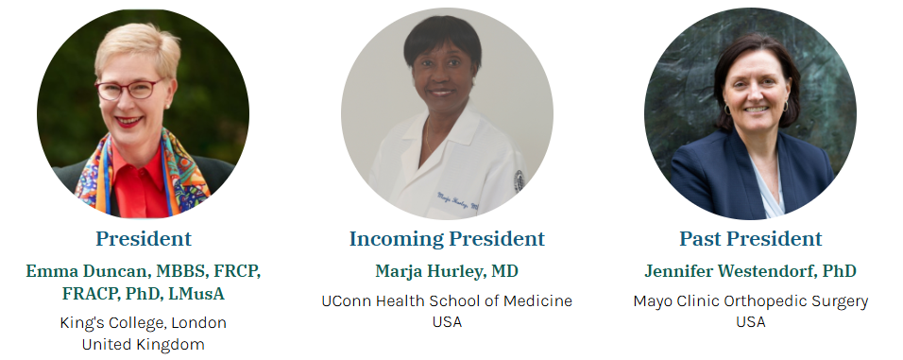
How to Network
Set Goals:
    What do you want out of the interaction?
Do Your Homework:
    Is there someone specific you want to meet look them up on the Itinerary app see what sessions they may be at
    Introduce yourself or have your PI/someone you know introduce you
Prepare an introduction:
Follow up!
Some people who you may want to meet are:
Follow @asbmrpres
https://www.asbmr.org/About/Leadership

Slide 29

Networking: Mini and Micro Elevator Pitches
Mini
Who is this for?
  PIs, one-on-one meetings, vendors
What information should this include?
  YOU: name, career stage, where you are from (city, university, lab)
  Research: What the focus and importance of your research is; “thesis”
How long?
  15-30 seconds
Micro
Who is this for?
  Group settings, networking events with 4+ people, peer-to-peer introductions
What information should this include?
  YOU: name, career stage, where you are from (city, university, lab)
  Research keywords
How long?
  3-10 seconds

Slide 30

Where to Network
Informal Networking
ESI Game Night (Kings Entertainment, Thursday, October 8, 6-9 PM)
Welcome Reception during Plenary Poster Session (Exhibit Hall C&D, Friday, 10/9, 5:30-7 PM)
Coffee Breaks/Networking Breaks (Hallways)
ASBMR Social Networking Event* (John B. Hynes Veterans Memorial Convention Center, Saturday, 10/10, 8:30-11 PM)
Social Media (X/BlueSky)
*Additional registration fee

Slide 31
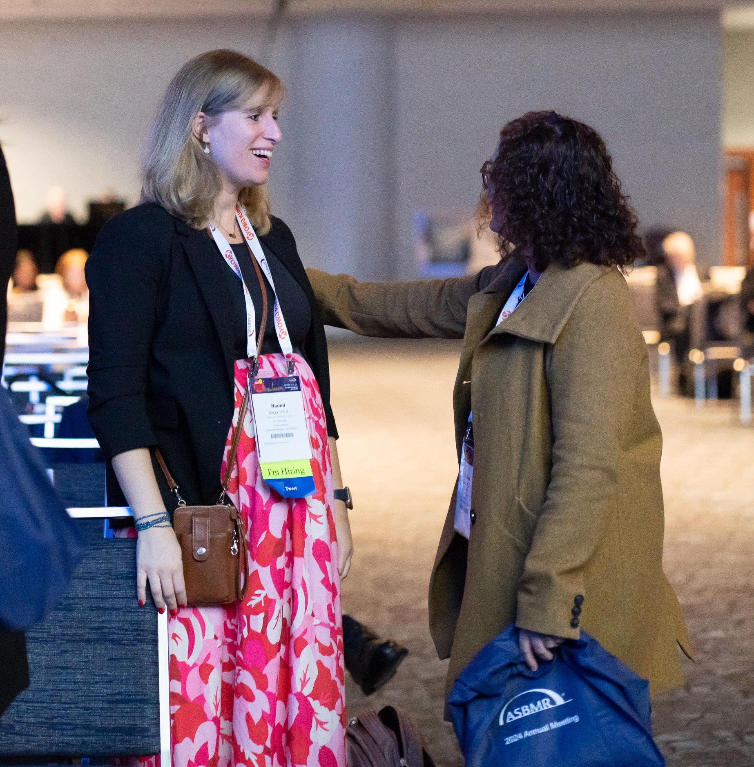
Networking vs. Connecting
Networking is about knowing more people. Connecting is about knowing people more.
Networking is more than meeting someone.
Peer-to-peer networking is just as important as meeting with PIs.
  Invite other people to join you for a coffee, or lunch or dinner, or to go explore the city together
Being INCLUSIVE is ACTIVE

Slide 32
Balance:
Active engagement/conference burnout

Slide 33
Balance active engagement vs. conference burnout
Don’t let FOMO get the best of you
Stay Healthy
ESI program highlights

Slide 34
F(ear) O(f) M(issing) O(ut)
DO:
Follow your itinerary
Schedule time to recharge and explore
  Take the time you need to perform your best
Prioritize people over paper
  Seeing posters and attending presentations are great, but conferences are opportunities to get to meet people
Take advantage of ESI mics
Browse social media recaps
DO NOT:
  Attend every session
  Try to see every poster
  Skip meals and water/coffee breaks
YOU CANNOT SEE EVERYTHING
…and that's OK!

Slide 35

Stay Healthy
Bring a water bottle to the conference
  Plus electrolyte powder
Bring a sweater/jacket
  The convention center tends to be cold
Pack some snacks
Take vitamin C and immune support
  Before, during, and after the conference
Bring pain relief
  “Conference Kit”
  Band-Aids and Moleskin
  Ibuprofen, Aspirin, etc.
Eat real meals
Sleep

Slide 36

Early Stage Investigator (ESI) Highlights
Career Development Workshops
  Meet the NIH
  Bone 101: Fundamentals of Bone Biology
  The Multiverse of Science Careers
  Meet the Professor Sessions
Early Career Spotlight Rapid Fire
  Some of the top scoring plenary posters from early-stage investigators will be presented in a rapid-fire presentation format – Exhibit Hall
Other great opportunities
  Thursday night ESI Game Night at Kings Entertainment
  ESI microphone during oral presentations
ESI Program details

Slide 37
Reflect + Follow-up

Slide 38

Reflect + Follow-up
Turn your key takeaways from the meeting into a lab presentation
  Synthesize the abstracts and notes you took on a few presentations and posters
  Focus on how this work is related to your own, or the work in your lab
  Write down some follow up questions about the work
  Make a presentation
Follow-up with PIs and peers (email, LinkedIn, Twitter/X, BlueSky)
  Write the emails now while the questions are still fresh in your mind
  Make sure to send emails/reach out!
  If you met with a PI, send a thank you email

Slide 39
If you forget everything else, remember this…
Prepare in advance
Know your location
Balance active engagement and conference burnout
Networking comes in many forms
Reflect and follow-up

Slide 40


Thank You!
Questions?
@ASBMR
Itinerary Builder
& ASBMR 2026 App
Early-Stage Investigator Program & Career Development Sessions
@asbmr.bsky.social
emilyq@wustl.edu, jstains@som.umaryland.edu, lsurface@umich.edu, asbmr@asbmr.org

